Slide 1
AWS-Cloud Computing

Slide 2
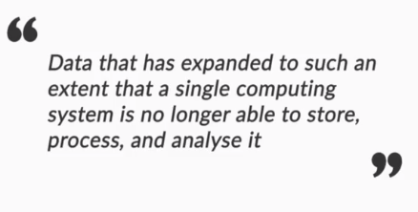
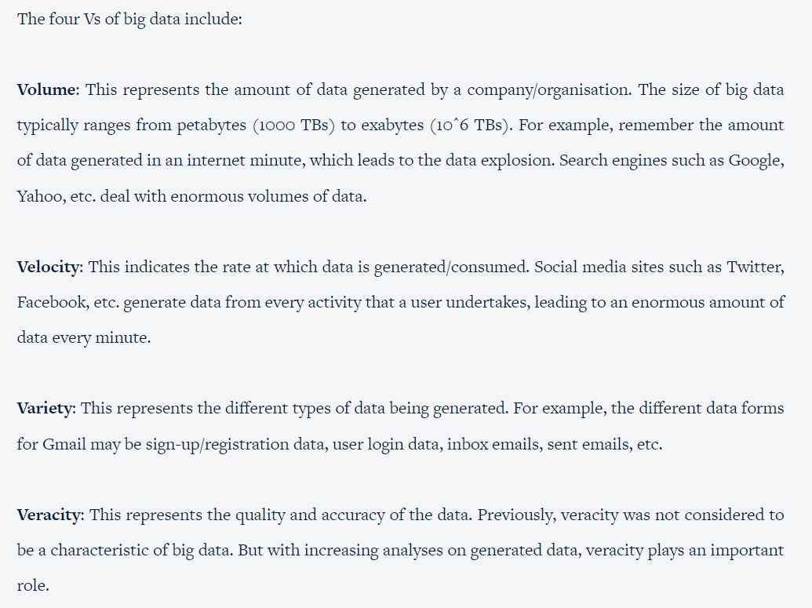
Big Data –

Slide 3
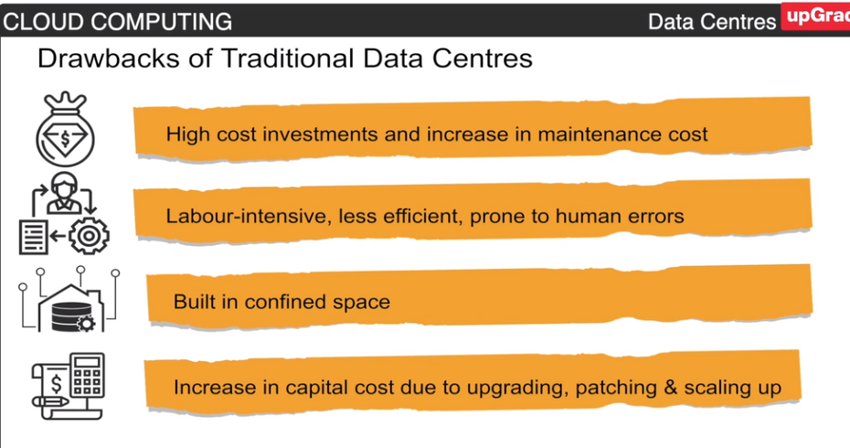
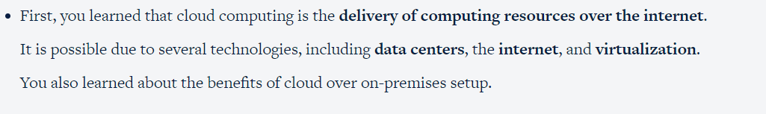

Slide 4
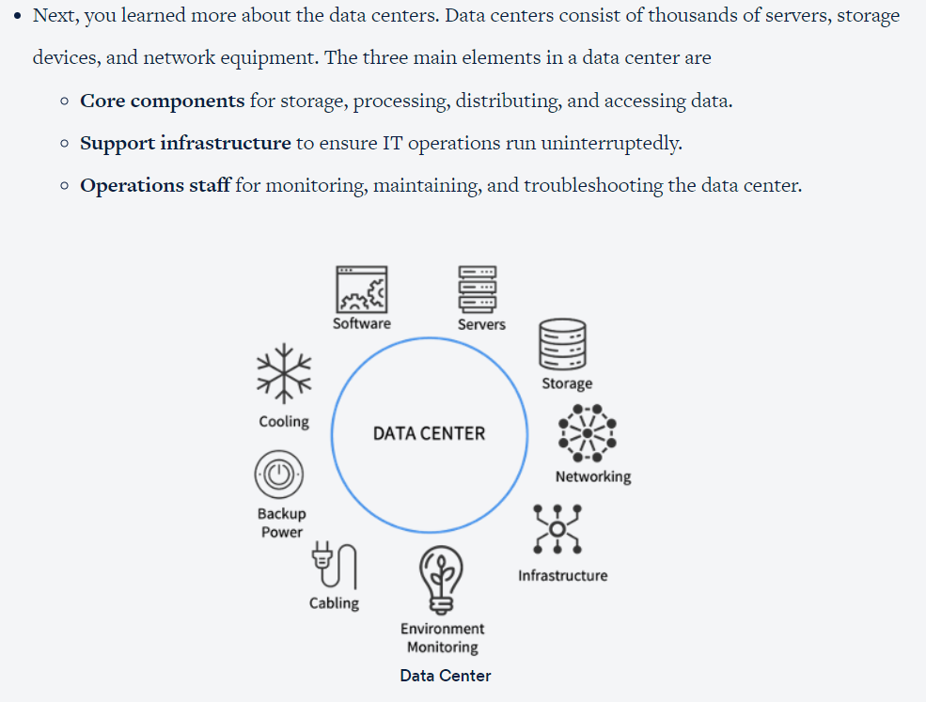
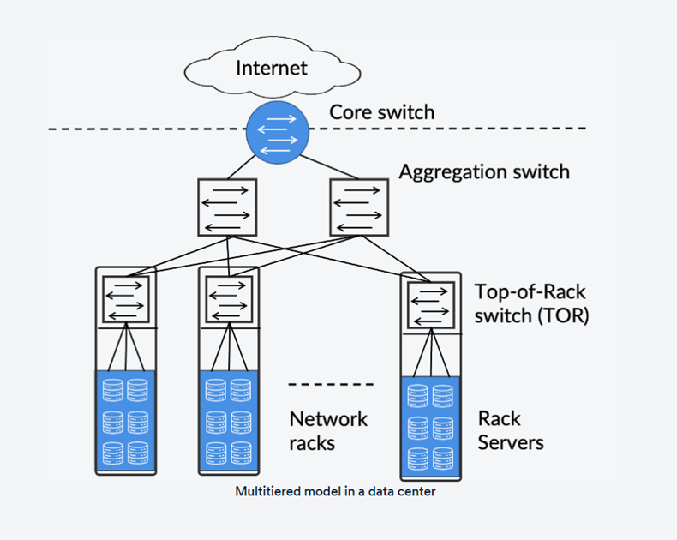
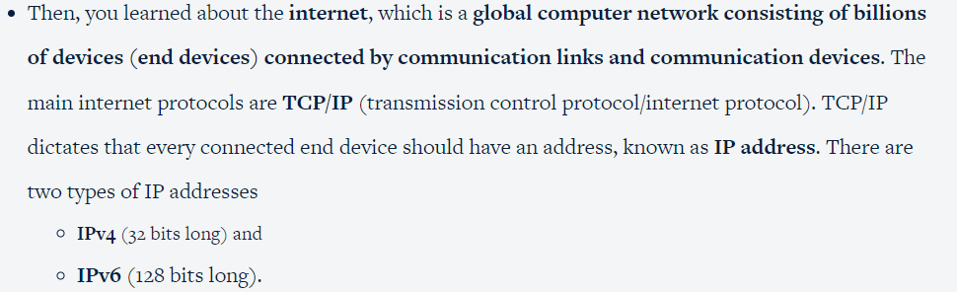

Slide 5
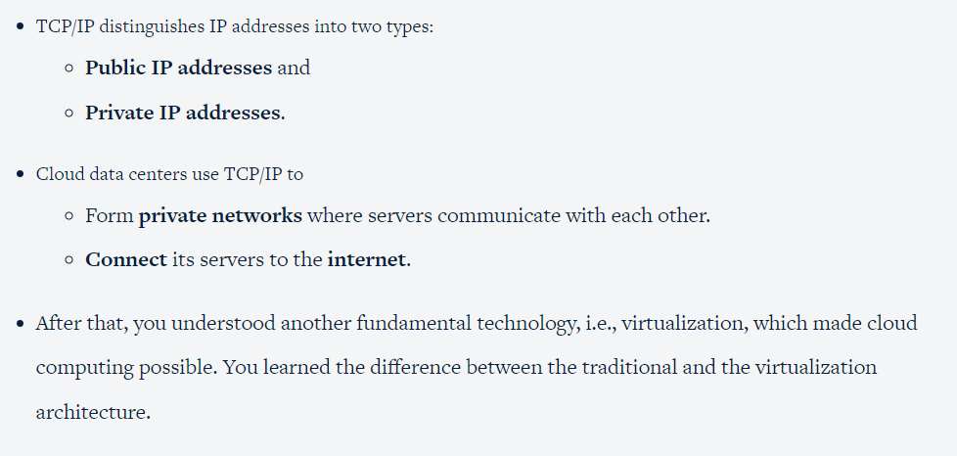
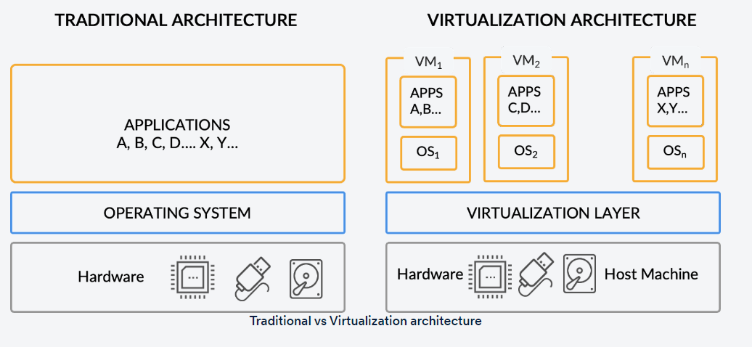

Slide 6
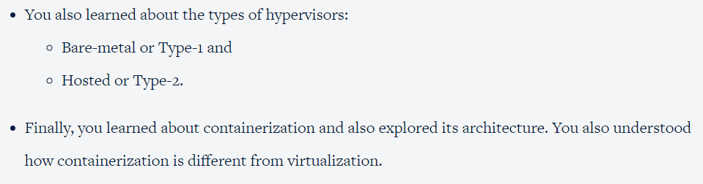
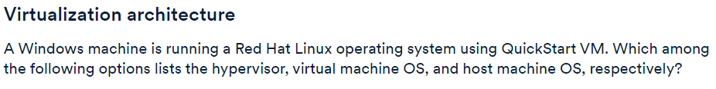
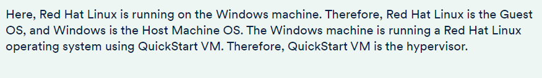

Slide 7
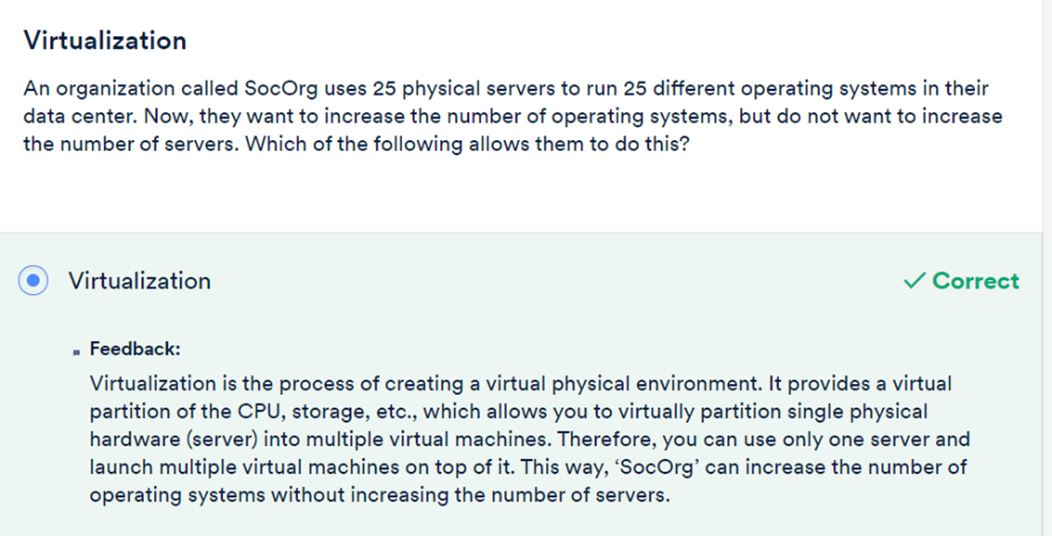
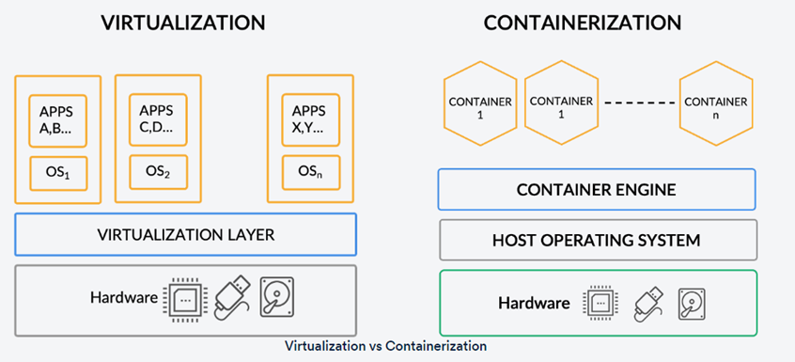

Slide 8
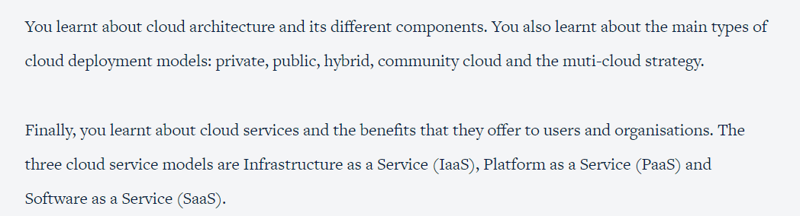
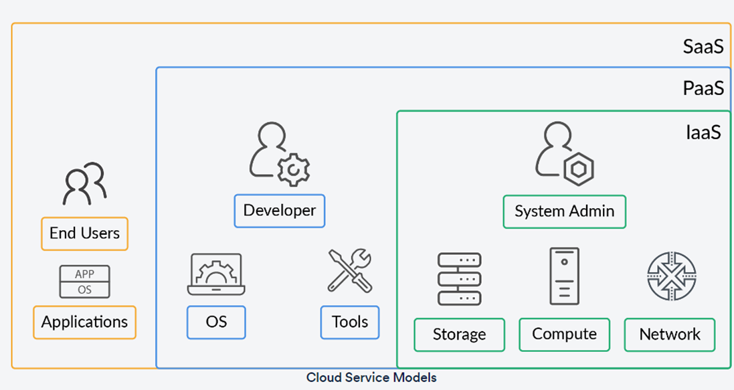

Slide 9
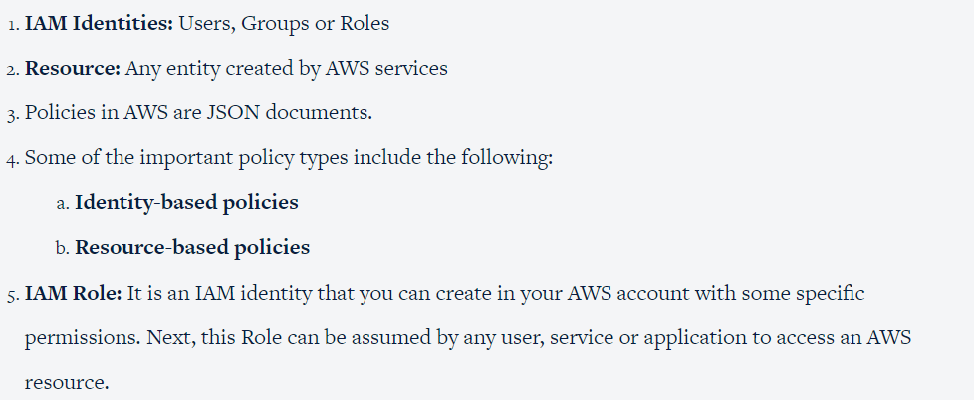
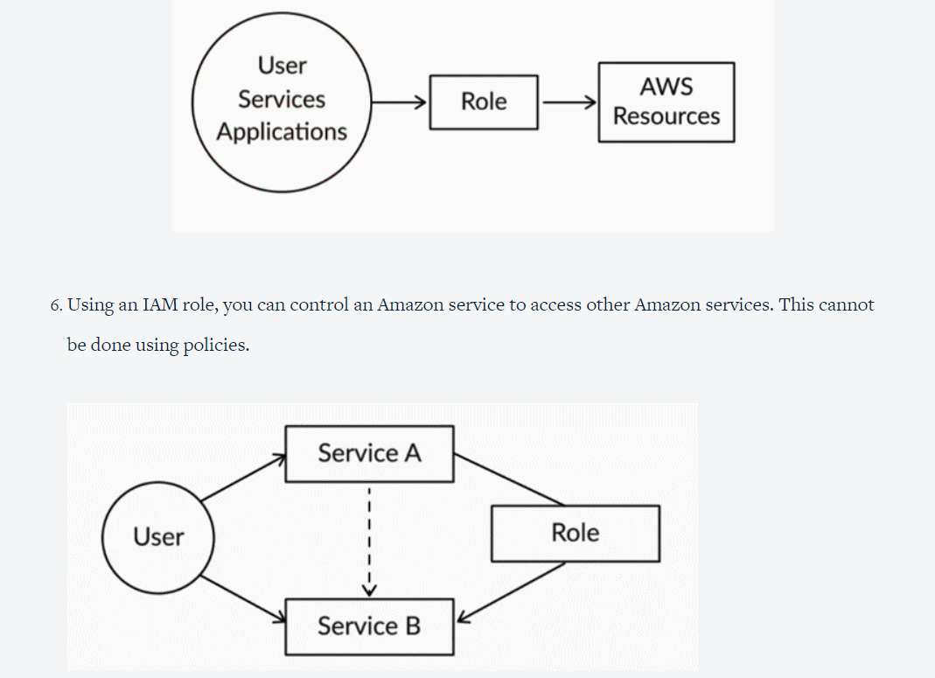
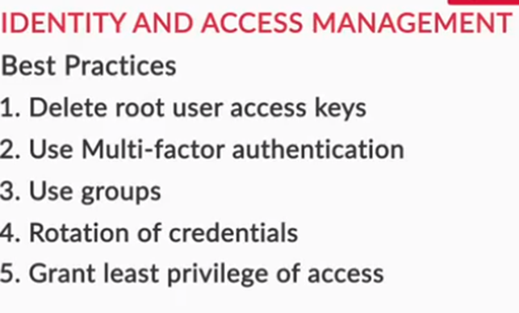

Slide 10
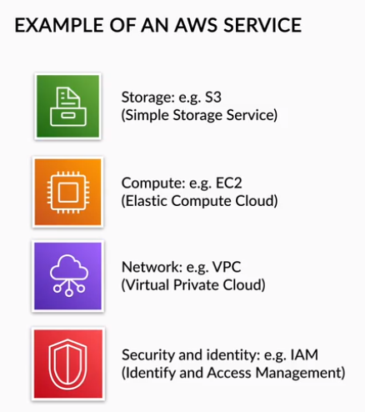
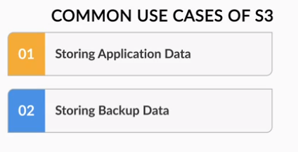
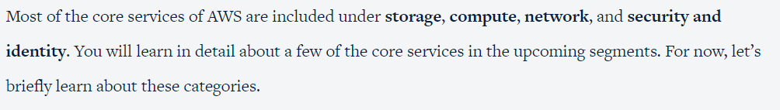

Slide 11
Storage
Cloud storage allows us to store data and is a critical component in any cloud-based application. It is a method of storing, retrieving, and sharing data among multiple users.
There are three types of cloud storage on AWS:
Object storage: Object storage is a flat structure in which files are broken into separate pieces or objects and are kept in a single repository or flat environment instead of being kept in separate files and folders. It is like keeping all the data units (objects) in one large storage pool. This kind of storage can handle large amounts of unstructured data easily and has practically unlimited scalability. Object storage solutions like Amazon Simple Storage Service (Amazon S3) are ideal for building new applications from scratch which require scalability and flexibility. ​​Amazon S3 allows you to access data from anywhere and on a massive scale. Data in S3 is stored as objects in resources known as buckets
File storage: File storage uses metadata and directories to organize data in files that are stored inside a folder. It’s like a file cabinet where you have specific drawers and within those drawers, you have specific folders which contain data as files. This kind of storage is easy to access on a small scale but not good for large-scale data storage. Amazon Elastic File System (EFS) is one example of file storage in AWS.
Block Storage: In block storage, data is divided into fixed-sized chunks, known as blocks, and each block is assigned a unique identifier. These blocks can be stored in different environments, such as one block in Windows and the rest in Ubuntu. They are fast and easy to modify. Examples of block storage in AWS include Amazon Elastic Block Store (EBS).

Slide 12
Compute
Amazon offers a wide range of computing services. Compute services are a set of physical servers in a data center that power an operating system through memory, processing, and storage infrastructure.
AWS offers a wide variety of computing resources that offer computing power for different functions. Amazon compute services include AWS Elastic Compute Cloud (or amazon EC2), AWS Lambda, and AWS Elastic Beanstalk.
Amazon EC2 allows you to obtain virtual compute capacity. In EC2, a virtual machine is known as an instance. Instances can be created with various configurations encompassing CPU, RAM, bandwidth, and operating systems. EC2 is an elastic service, meaning the services can be scaled up or down depending upon the requirements.
Amazon EC2 instances are billed per second increment. The actual price depends on the instance type and the plan you choose. There are three main plans:
On-demand services are launched as per requirement and are suitable for short-term, unpredictable workloads.
Reserved instances are used for steady workloads. Users need to reserve such instances by pre-booking them.
Spot instances are suitable for workloads that have flexible start and end. The price is adjusted based on usage.

Slide 13
Network
AWS accounts have a virtual network environment where they can launch their resources. One of the examples of this virtual network is Virtual Private Cloud or VPC, which connects resources from multiple availability zones within the same region. AWS allows you to create multiple VPCs that are isolated from one another.
AWS networking services can be categorized into various components:
Network foundations: These services are used within the AWS to connect internal cloud services and connect services to external users. Amazon VPC is an example of a network foundation. AWS gives you complete control of the VPC configuration so that you can decide what is exposed to the internet. Amazon VPC also allows you to create subnets, control and monitor the traffic, and create firewalls and gateways.
Hybrid connectivity: These services are used to connect the AWS cloud and the user’s on-premises network. AWS Virtual Private Network (VPN) is an example of hybrid connectivity.
Application networking: These services allow you to monitor each component of the services in a streamlined manner. AWS Cloud Map is an example of application networking.

Slide 14
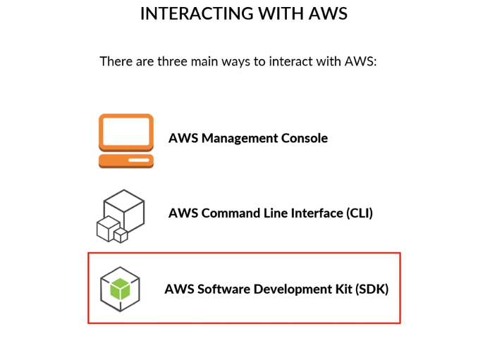
You can access the AWS platform in three different ways:
AWS Management Console: It is a web browser-based interface. Services are grouped into categories, and you can access all of them manually. It is the easiest way to manage resources on AWS. It has a convenient GUI (Graphical User Interface) and runs smoothly in almost every modern web browser. For new learners in AWS, the management console is the best place to start. You can find all the information regarding your AWS account in the interface.
AWS Command Line Interface (CLI): AWS CLI allows you to manage the AWS environment using a terminal rather than a graphical user interface. It is a tool that allows us to issue commands. One of the main advantages of the CLI is that you can automate your interaction with AWS through scripts.
AWS Software Development Kits (SDK): They are a set of libraries for different programming languages that allows you to develop and manage applications that use AWS resources.

Slide 15
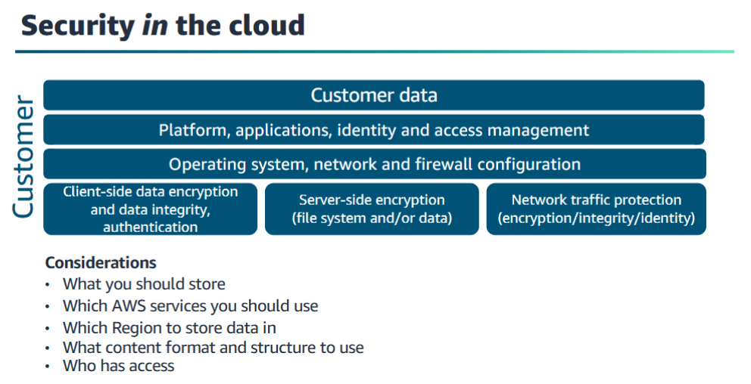

Slide 16
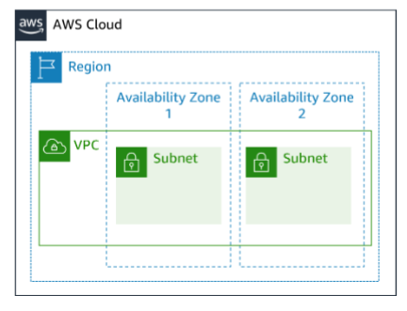
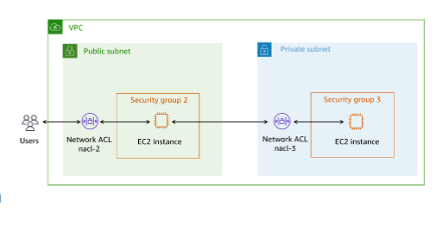

Slide 17
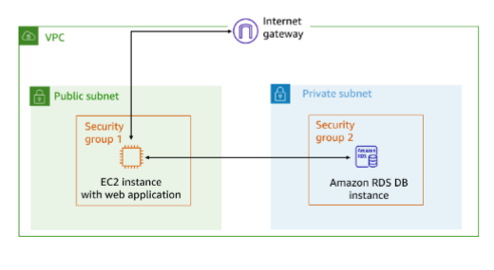
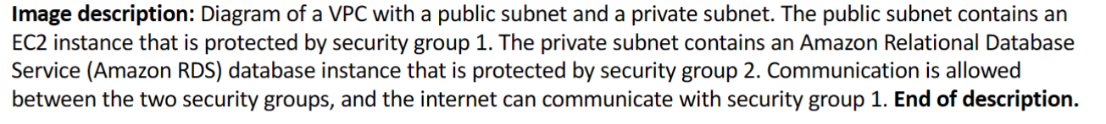

Slide 18
